Slide 1
Discrete Fourier Transform II
Slides come from https://www.bilibili.com/video/av44600709
Ying shen
School of software engineering
Tongji university

Slide 2
Zero Padding

Slide 3
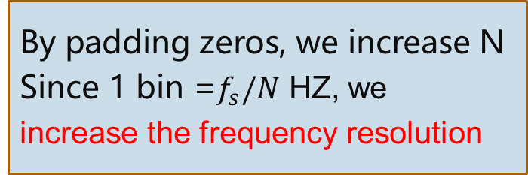
Zero padding
N=8
N=16
N=32
By padding zeros, we increase N
Since 1 bin =$f_{s}/N$ HZ, we
increase the frequency resolution
N=64
Notes:
y1 = fft(signal1,8);
y2 = fft(signal1,16);
y3 = fft(signal1,32);
y4 = fft(signal1,64);

Slide 4
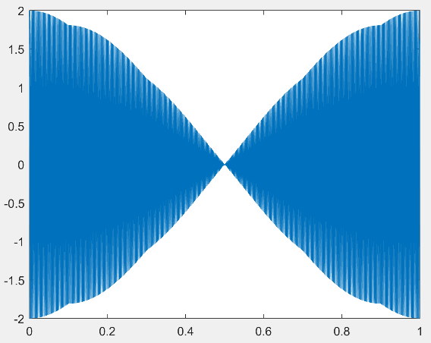





Zero padding
$$x\left(t\right)=\cos\left(2π∗440t\right)+\cos\left(2π∗441t\right)$$
Given a sample rate $f_{s}=4410HZ$
$$x\left[n\right]=\cos\left(2π∗440∗\frac{n}{4410}\right)+\cos\left(2π∗441\frac{n}{4410}\right), n=0,…,4409$$
$$N=4410$$
$$N=8192$$
HZ
HZ
HZ
$$N=16384$$
$$N=32768$$
HZ
HZ

Slide 5

Zero padding
$$N=16384$$

Slide 6
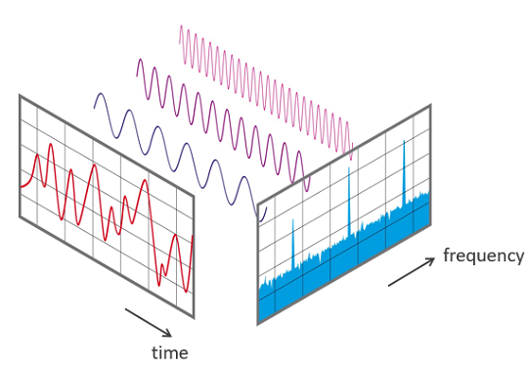
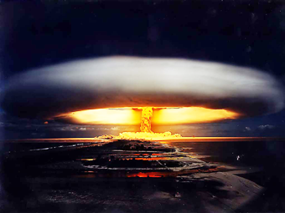
What is FFT (Fast-Fourier-Transform)?
FFT is not one algorithm, many scientists have invented different FFTs
However, today it mostly refers to the algorithm published by James Cooley and John Tukey in 1965 for the purpose of detecting the Soviet Union nuclear test from offshore sensors

Slide 7
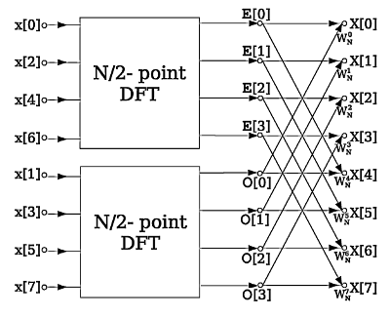






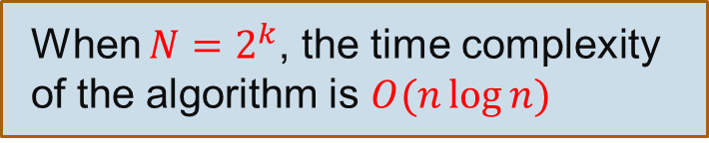

What is FFT (Fast-Fourier-Transform)?
If we choose $N=2^{k}$, $n_{1}$ and $n_{2}$ can be decomposed until length 2 DFTs!
$$O(N^{2})$$
If $N=n_{1}n_{2}$
DFT with length $n_{1}$
$$O(n_{1}^{2})$$
DFT with length N
+
DFT with length $n_{2}$
$$O(n_{2}^{2})$$
When $N=2^{k}$, the time complexity of the algorithm is $O(n\log{n})$

Slide 8
Windowing

Slide 9


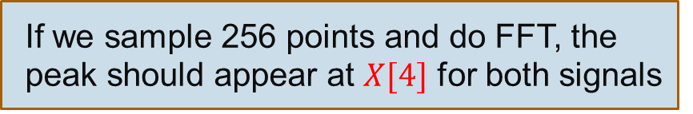
Windowing
Up to now, we assume that the signal oscillates k periods, where k is an integer
Problem with non-integer periods:
$$x_{1}\left[n\right]=\cos\left(2π∗4∗\frac{n}{256}\right), n=0,1,…255$$
$$x_{2}\left[n\right]=\cos\left(2π∗4∗\frac{n}{256}\right), n=0,1,…219$$
If we sample 256 points and do FFT, the peak should appear at $X[4]$ for both signals

Slide 10



Windowing
Time domain
FFT $N=256$
$$N=256$$
lower
$$N=220$$
Spectral Leakage
It seems less harmless if we only want to identify the frequency
But if we want to reconstruct the signal with the frequency representation

Slide 11
Windowing
Hanning Window

Slide 12
Windowing
FFT
Blackman
Hanning

Slide 13
Analyzing Long Signals by Short-Time Fourier Transform (STFT)

Slide 14

What does STFT do?
Producing a spectrogram for a long, non-stationary audio signal
FFT spectrum on the entire signal
660HZ
440HZ
Notes:
fs=16000;
t1=0:1/fs:1-1/fs;
y1 = sin(2*pi*440*t1);
t2=0:1/fs:2-1/fs;
y2 = sin(2*pi*660*t2);
y3 = [y1 y2];
audiowrite('440-660hz-sound.wav', y, fs);
spectrogram(y3,256,240,256,16000,'yaxis');

Slide 15
STFT steps
frame length (typically 10-25ms)
hop size
Multiplied by the window function values
Calculate FFT spectrum
Get the spectrum array for the 1st frame:
[0 0 … 29.9 33.2 36.6 40.0 …]
Get the spectrum array for the 2nd frame:
…

Slide 16
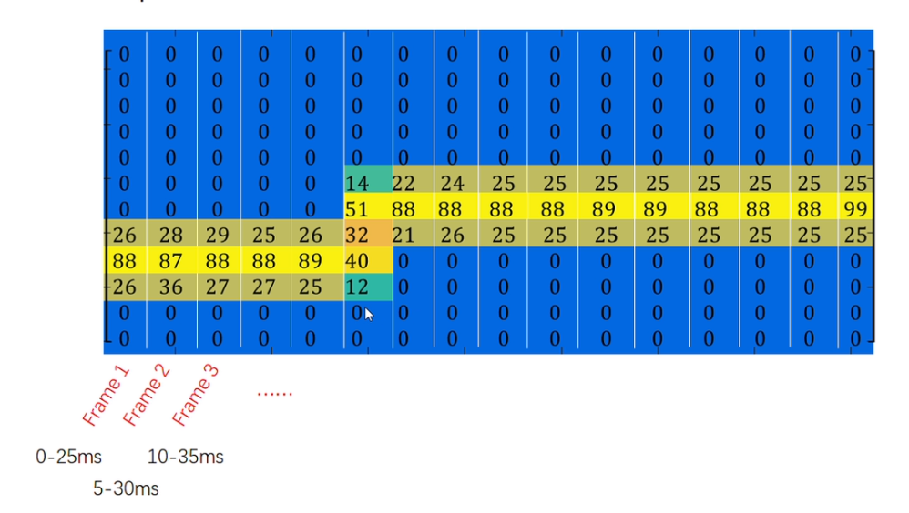
STFT steps
Questions
What is the unit of the horizontal/vertical axis?
What will happen if we increase/decrease the frame length?
What will happen if we change the hop size?

Slide 17
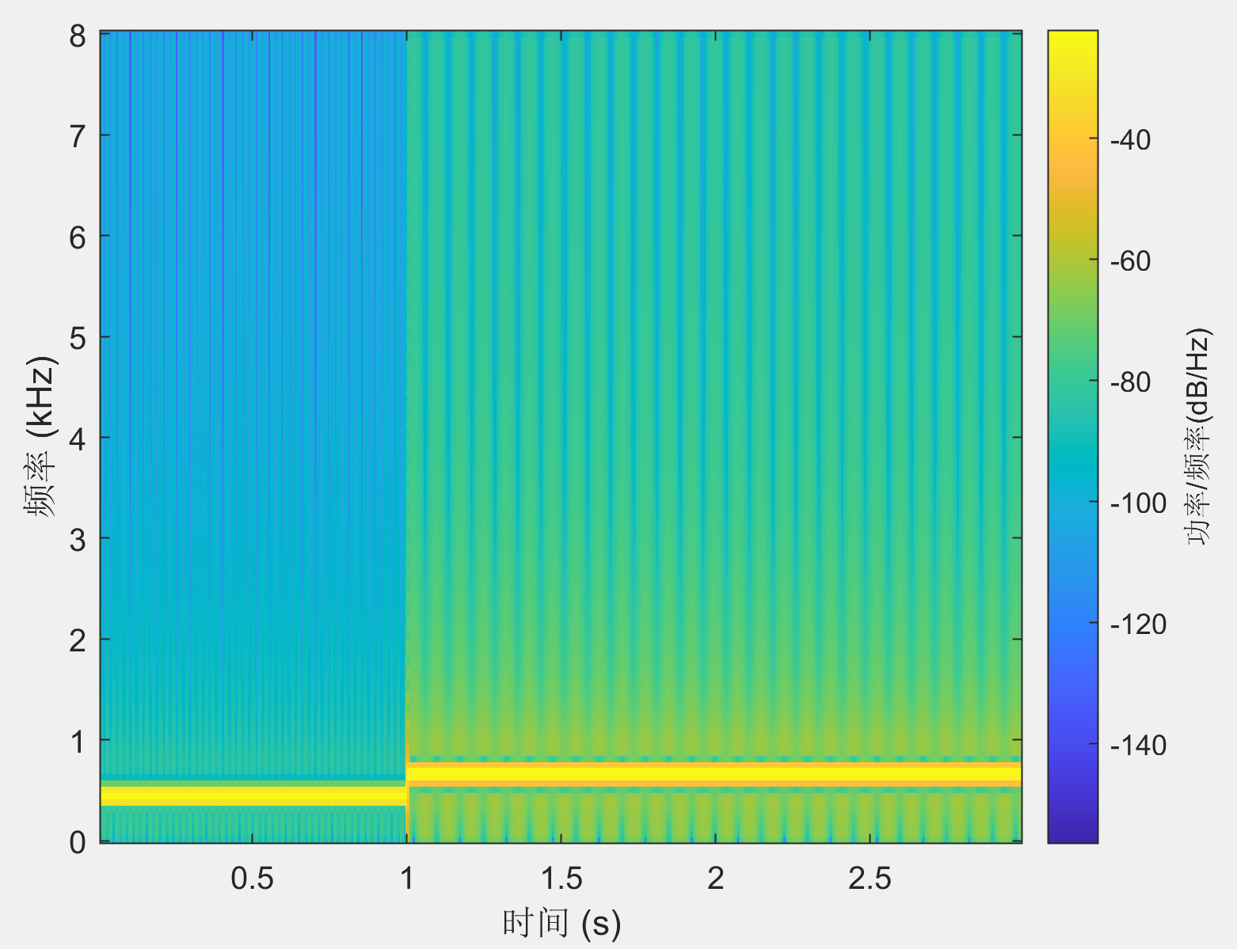
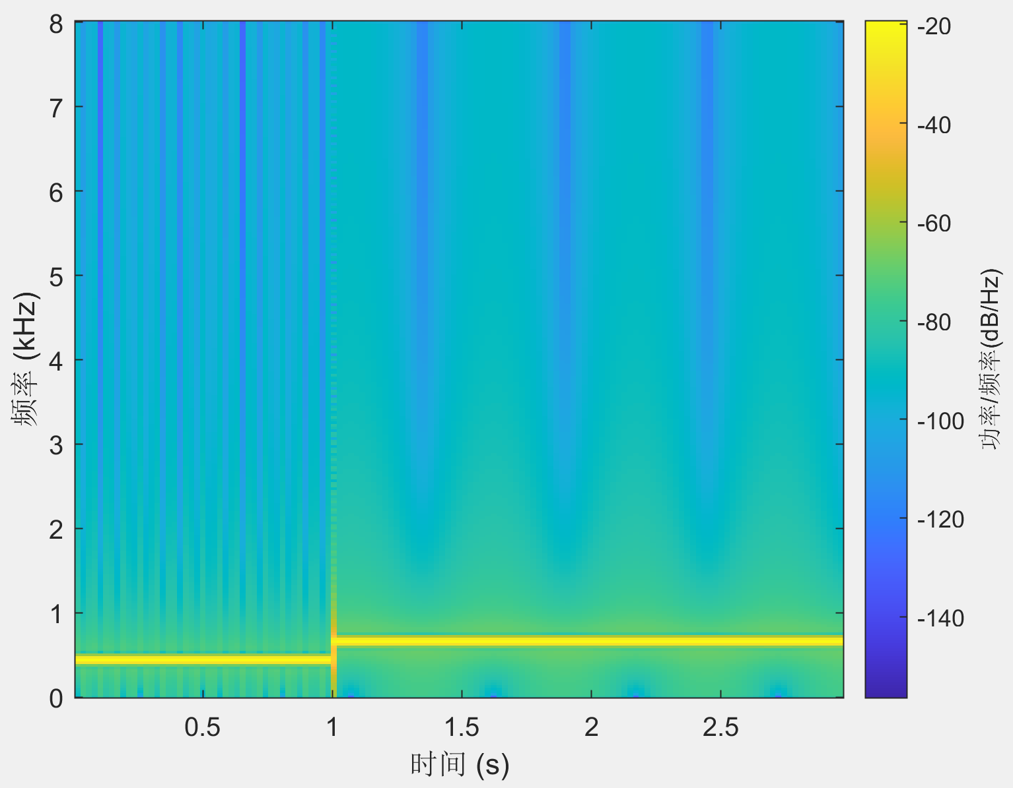
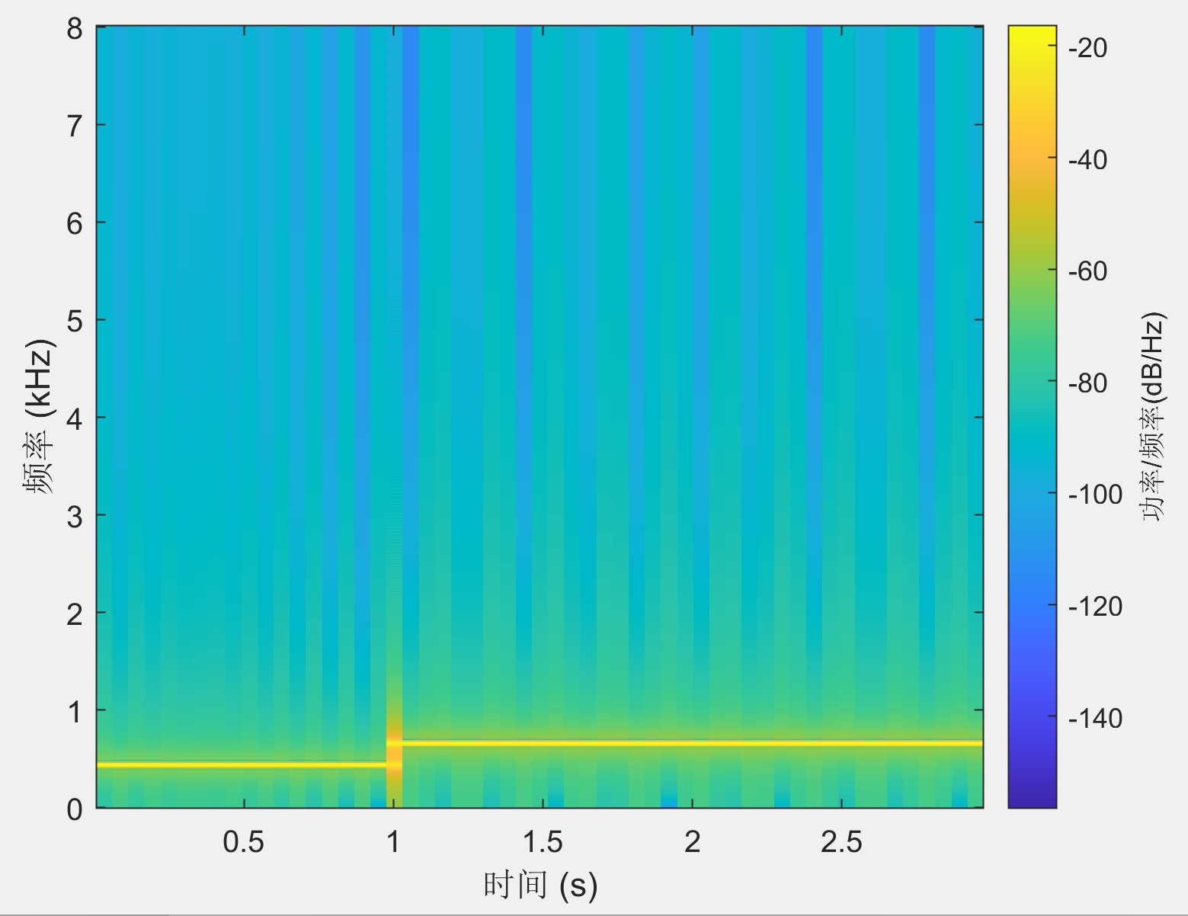
Changing window size
W= 256, overlap= 160
W= 512, overlap= 160
W= 1024, overlap= 160

Slide 18
Changing hop size
W=1024, overlap= 10
W=1024, overlap=512
W=1024, overlap=960
Notes:
If you specify noverlap as empty, then spectrogram uses a number that produces 50% overlap between segments.

